Slide 1

The Apprentice
Vocabulary Support for:
Pilar Molina Llorente

Slide 2
Vocabulary Checklist
(for all vocabulary instruction)
1. Provide opportunities for students to:
  read the word
  hear the word
  say the word
  write the word (if applicable)
2. Define the word with a “kid-friendly” definition
Provide opportunities for students to interact with the word and it’s meaning.
(Provide repeated and varied interactions with the word.)

Slide 3
Before Reading:
  Teacher introduces a vocabulary word by describing, explaining, translating, demonstrating and/or giving an example of the new word.
  Students interact with the word.
Opportunities for Student Interaction
Define the word in their own words. | Illustrate the word. | Use gestures to define the word.
Role play the meaning. | Create a song defining the word. | Teach the meaning of the words to another group.
Compare and contrast the meaning of two words. | Classify words according to content areas. | Record definitions in a glossary.
Develop a metaphor or analogy. | Participate in games and activities that promote the vocabulary word. | AFTER Gather instances of the words (signs, radio, T.V., media)

Slide 4
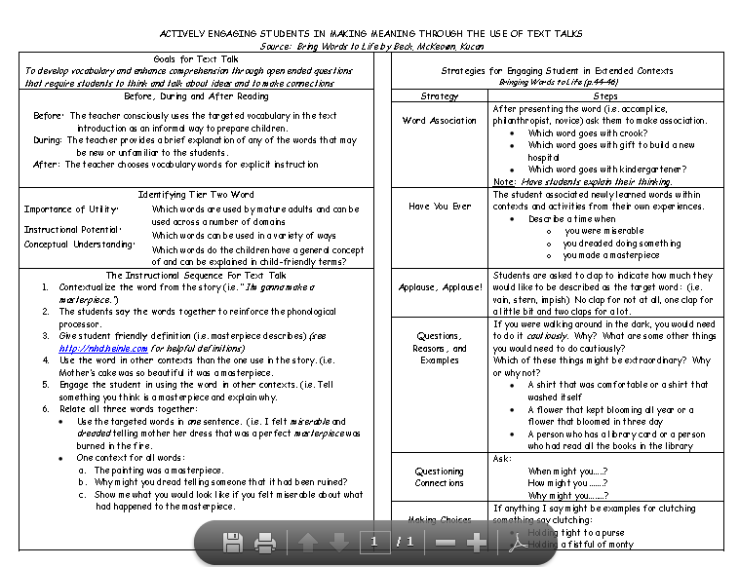
After Reading- Text Talk

Slide 5
Preface

Slide 6
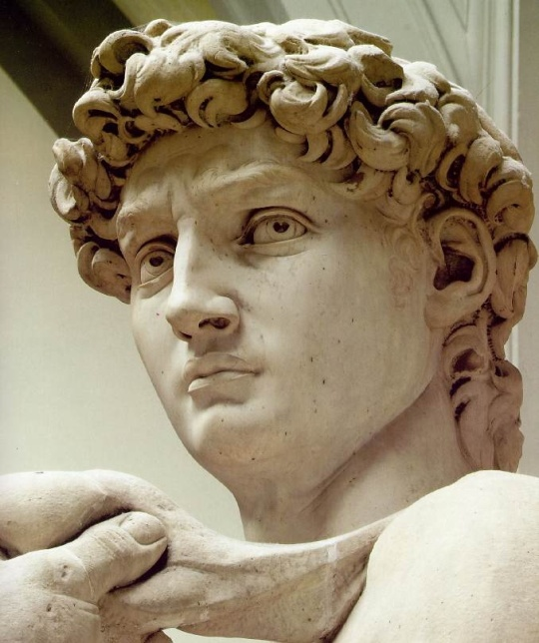
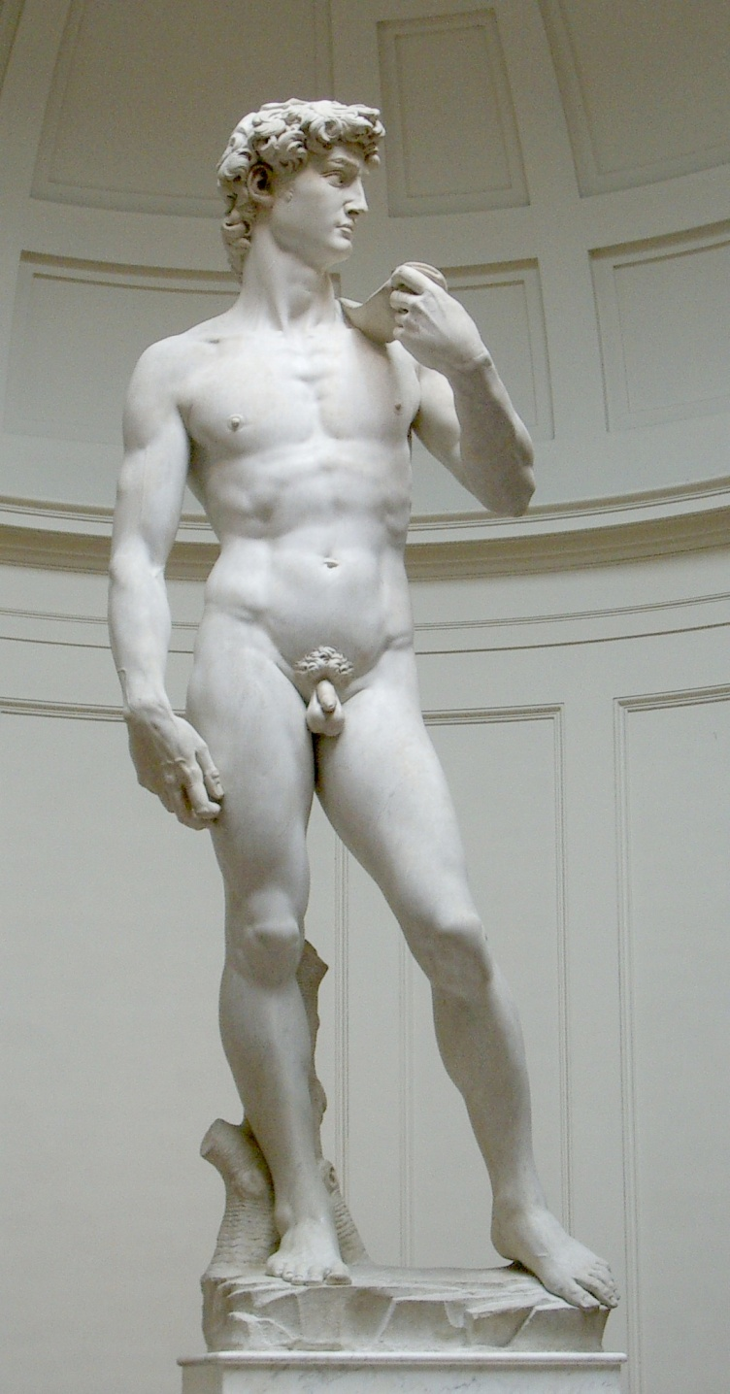
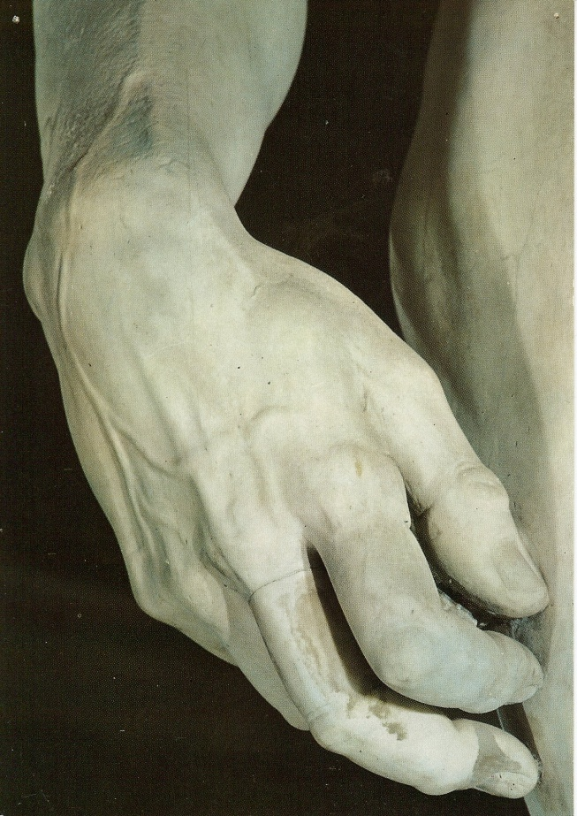
Sculpture
3 dimensional art made of stone, metal or other objects.
Michael Angelo’s Statue of David

Slide 7
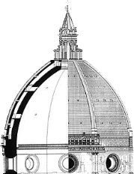
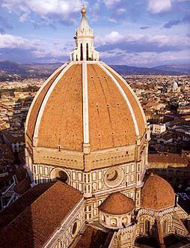
Brunelleschi’s Cupola
Florence, Italy
Architecture
The art and science of designing buildings and other structures.

Slide 8
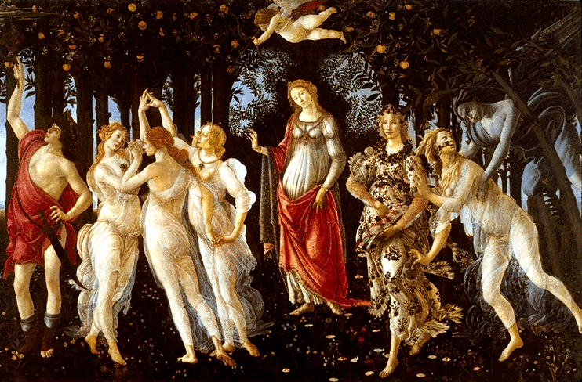
Painting
A painted work of art.
Botticelli’s Primavera

Slide 9
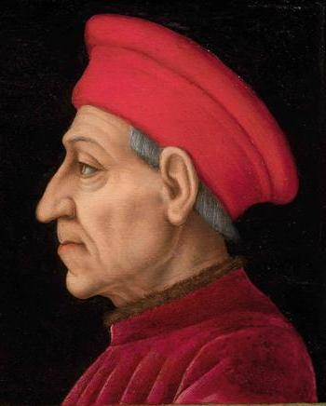
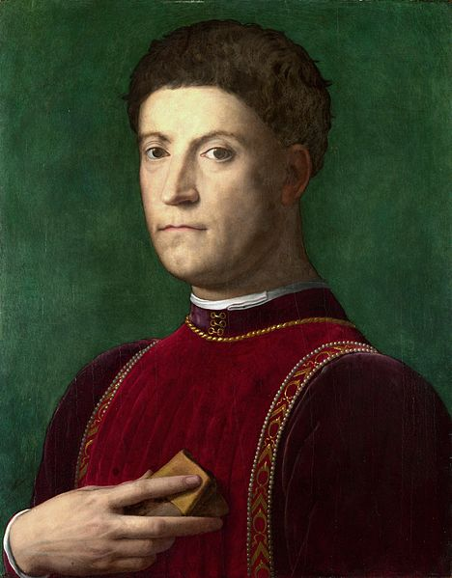
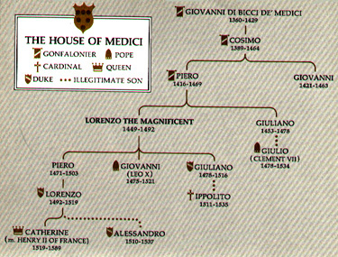
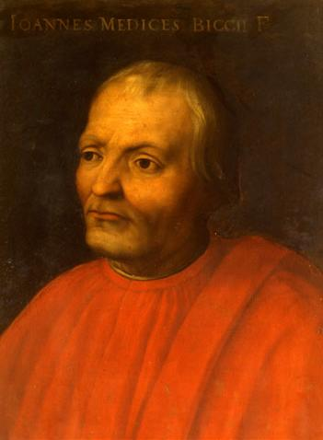
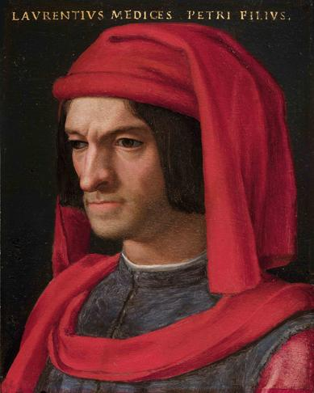
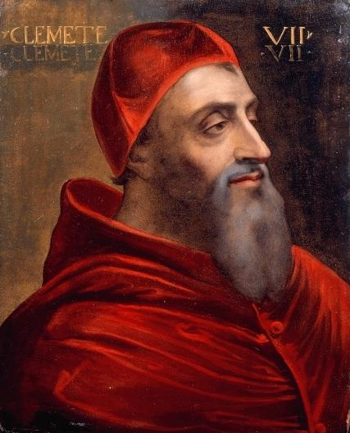
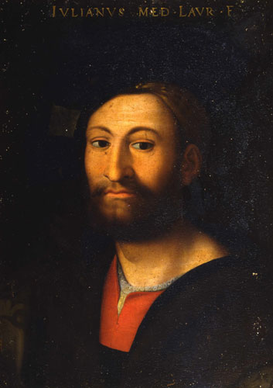
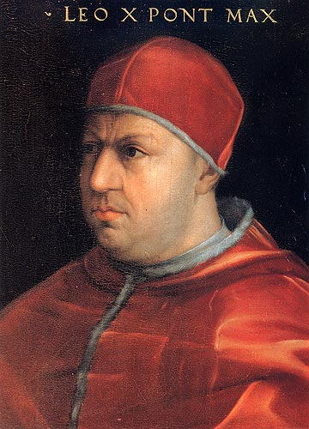
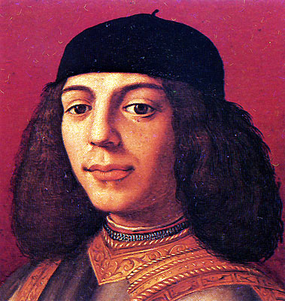
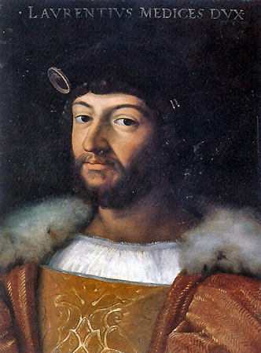
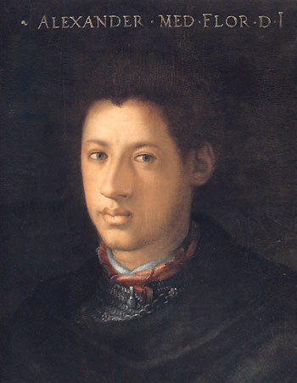
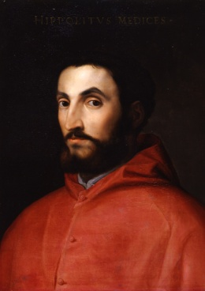
The Medici Family

Slide 10
Chapter 1

Slide 11
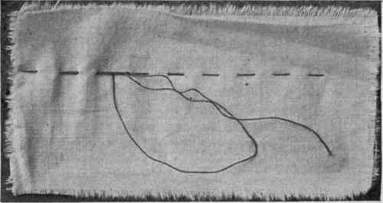
Basting
Long stitches that temporarily hold two pieces of fabric together

Slide 12
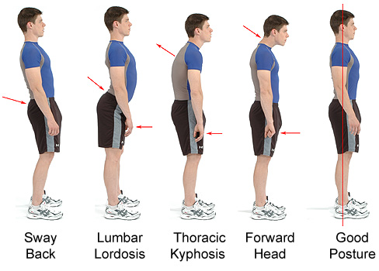
Posture
The way someone holds their body

Slide 13
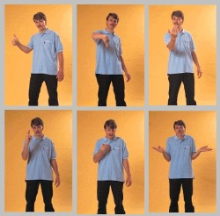
Gesture
A body movement that shows a feeling or idea.

Slide 14
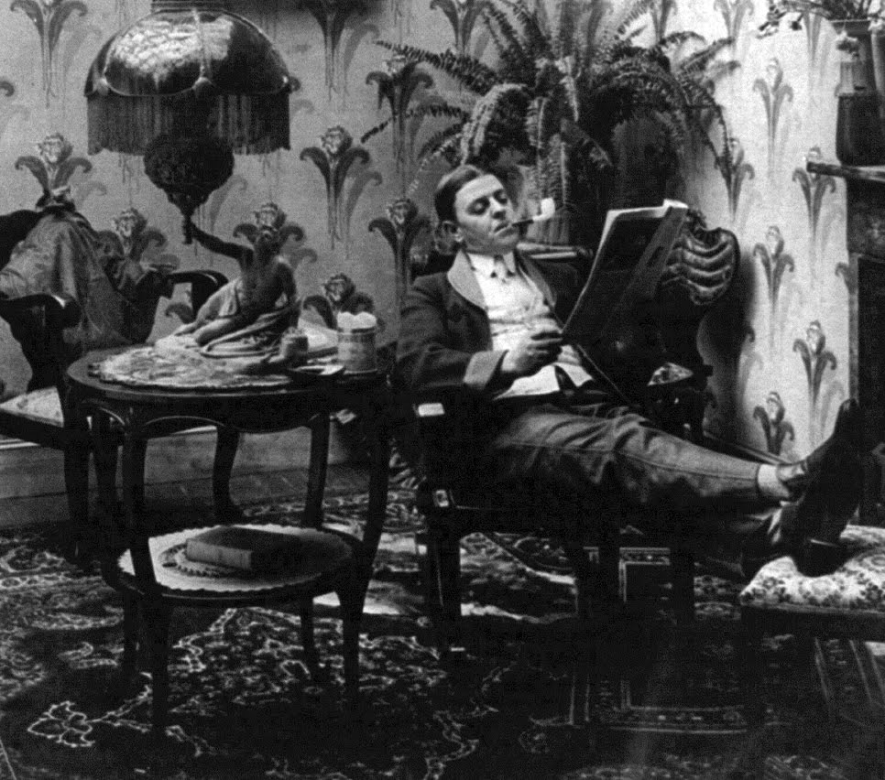
Illustrious
Famous; distinguished.

Slide 15
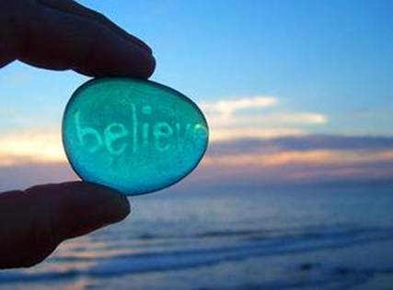
Conviction
A strong belief.

Slide 16
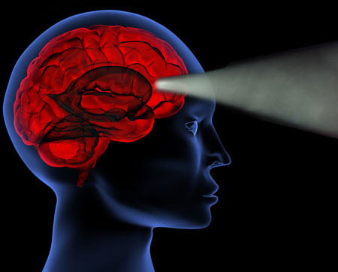
Intention
A desire, wish or goal.

Slide 17
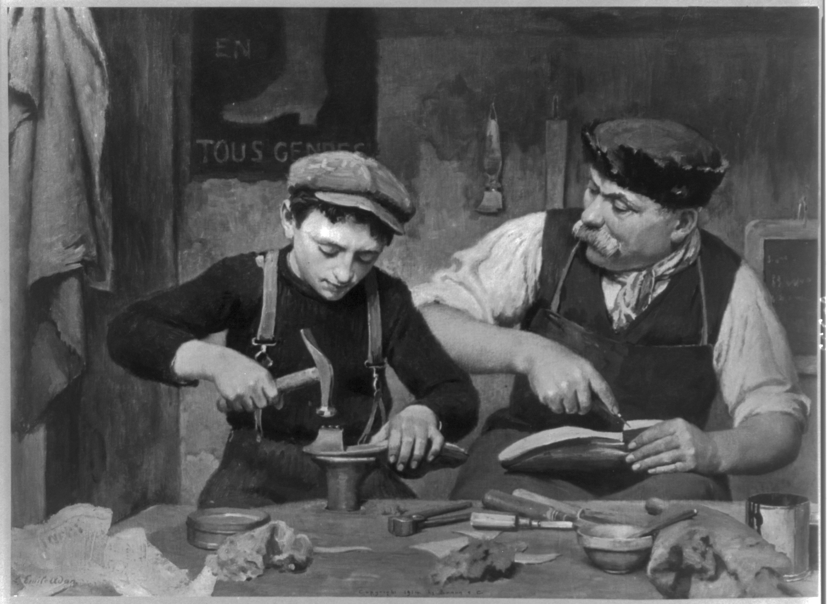
Apprenticeship
A period of time spent working with a master craftsman or an expert artist to learn a skill or trade,

Slide 18
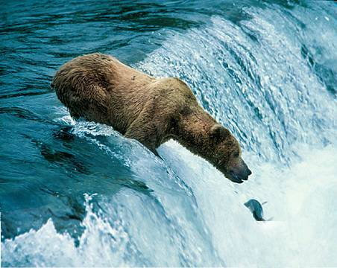
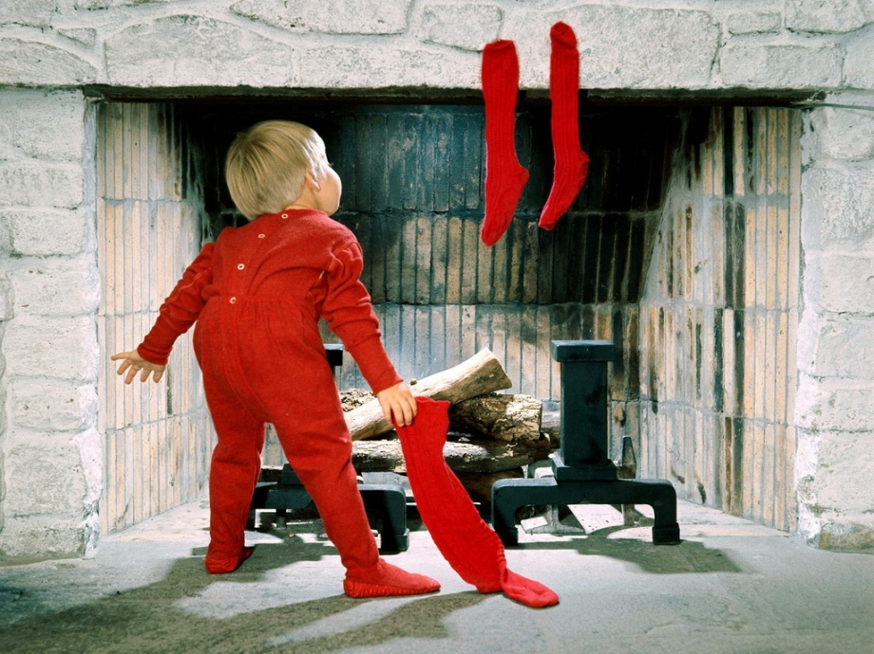
Anticipation
Believing something will happen.

Slide 19
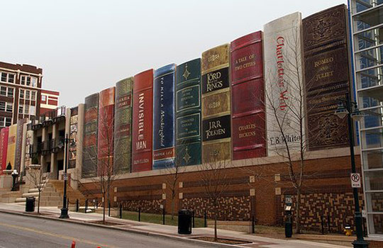
Facade
Front or outer covering of a building.

Slide 20
Chapter 2

Slide 21
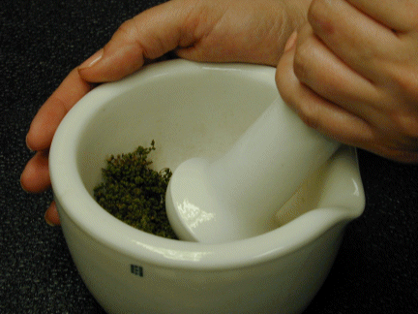
Mortar and Pestle
A tool used to crush and grind solid substances.

Slide 22
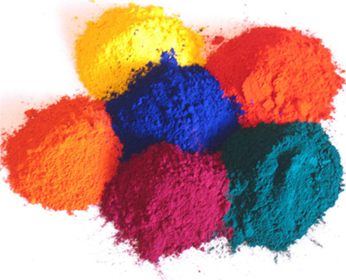
Pigment
A powder or paste of concentrated color that is used to mix with other substances to create paint or dye.

Slide 23
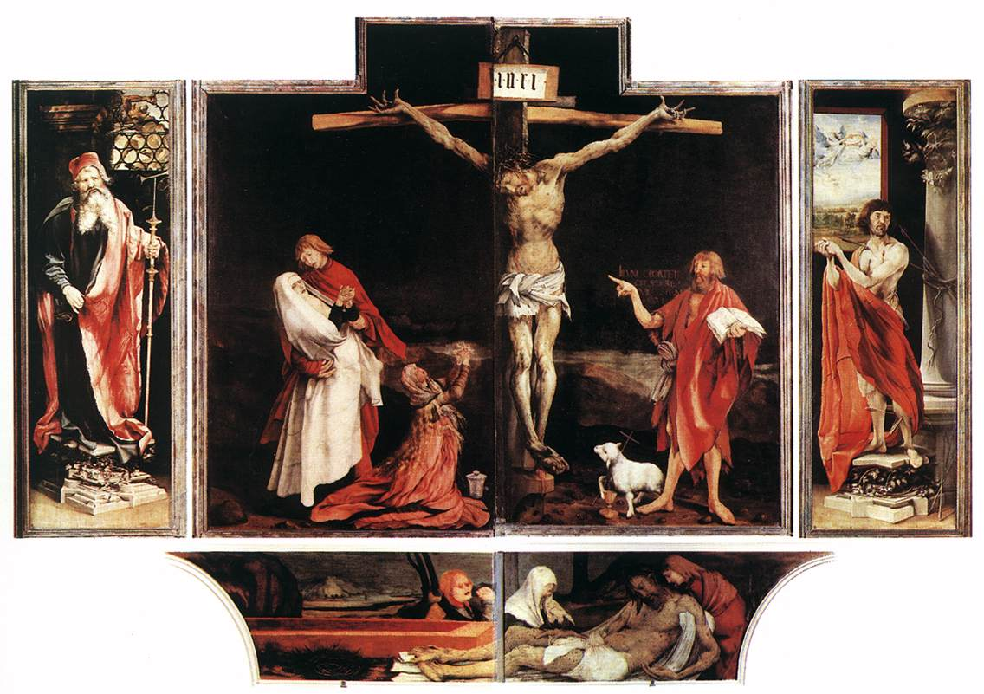
Altarpiece
A work of art that has been made to go above the altar in a Christian church.

Slide 24
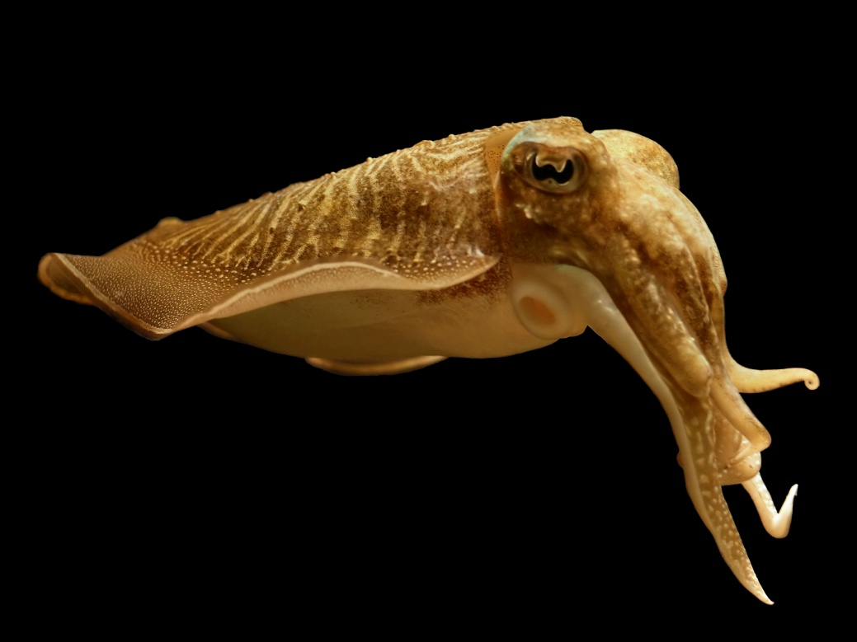
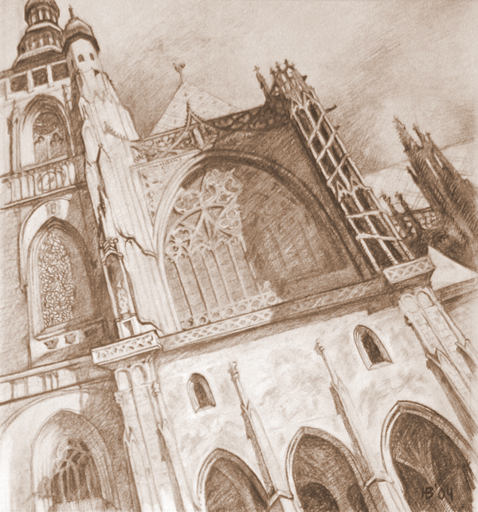
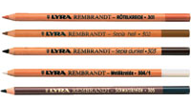
Sepia Pencil Drawing
Sepia is a dark brown-gray color named after the rich brown pigment derived from the ink sac of the common cuttlefish Sepia.

Slide 25
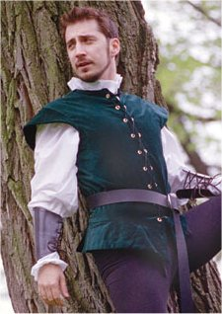
Doublet
A close-fitting jacket with or without sleeves.

Slide 26
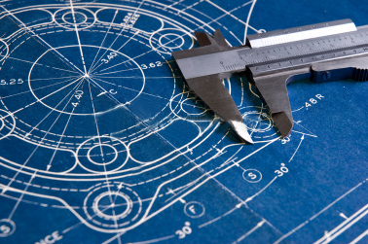
Precision
Paying attention to detail; exactness, accuracy.

Slide 27
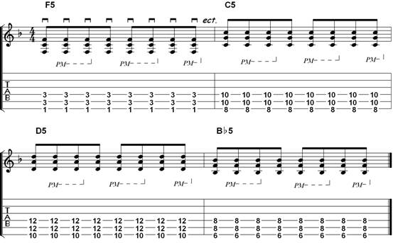
Syncopated
Cut short; abbreviated.

Slide 28
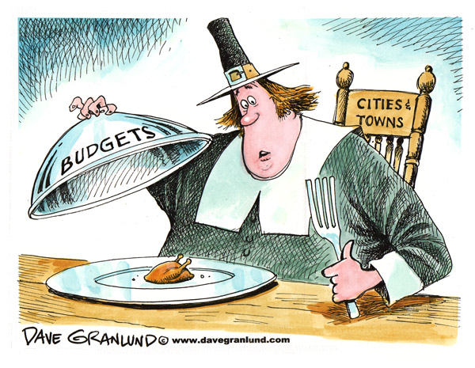
Meager
Very little; skimpy

Slide 29
Chapter 3

Slide 30
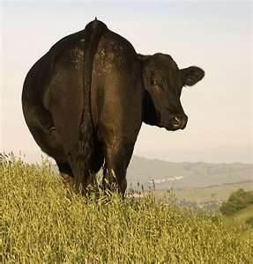
Ambled
To walk in a slow easy manner.

Slide 31
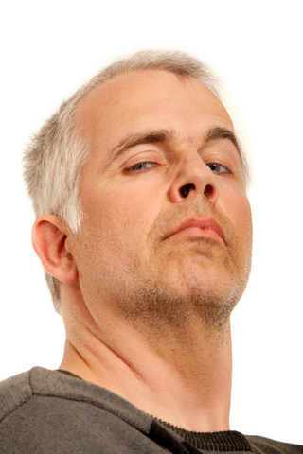
Haughty
Proud in a snobbish, arrogant way.

Slide 32
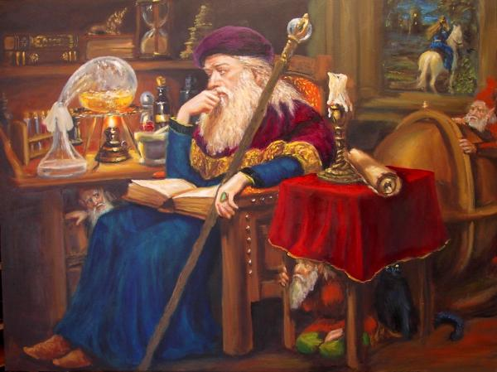
Alchemist
A scientist of the middle ages who tried to change other metals into gold.

Slide 33
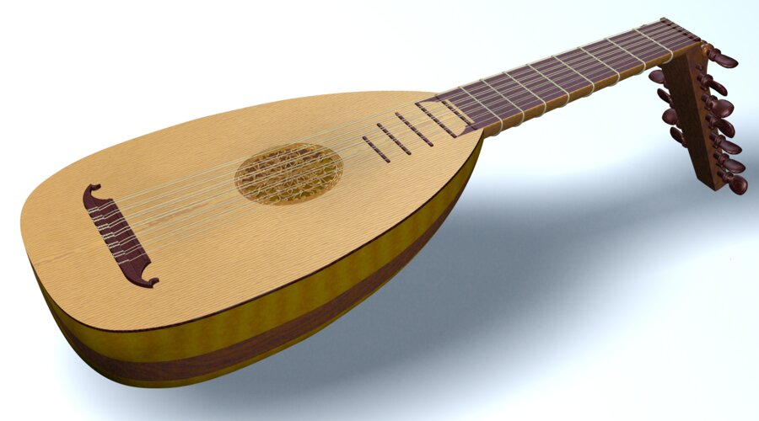
Lute
A plucked string instrument with a neck.

Slide 34
Chapter 4

Slide 35
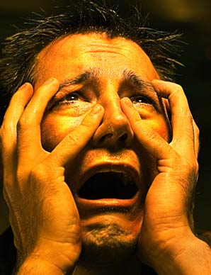
Anguish
To suffer painful sadness.

Slide 36
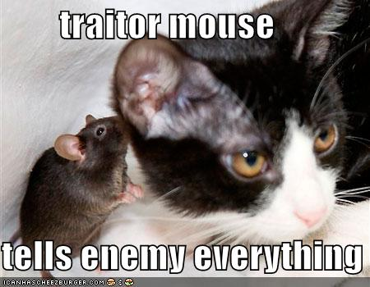
Traitor
Someone who betrays (goes against) another.

Slide 37
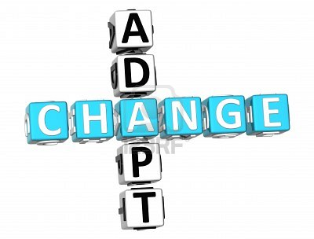
Adapt
A change that makes something work.

Slide 38
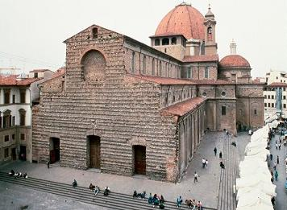
The Church of San Lorenzo

Slide 39
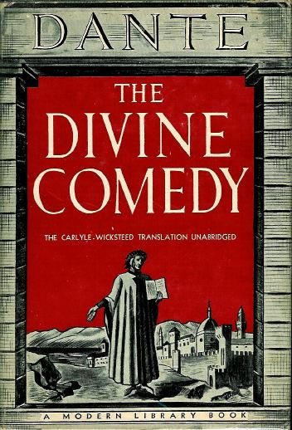

Slide 40
Chapter 5

Slide 41
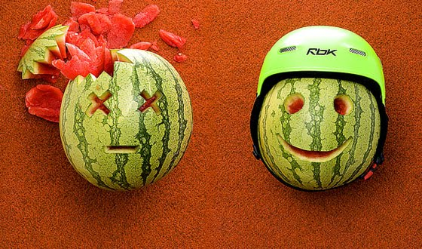

Obligation
Feeling like you MUST do something.

Slide 42

Denounce
To speak strongly against something.

Slide 43
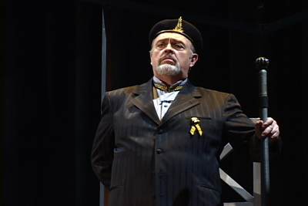
Tyrant
Someone who uses terror to enforce their way.

Slide 44

Cobbles of the Courtyard

Slide 45

Soldering Chain
To join together or fix metal by melting it and then allowing it to cool

Slide 46
Chapter 6

Slide 47


Tempered
Restrained

Slide 48

Entourage
A group of people who follow someone important.

Slide 49

Allegory
A story, poem or play where people, things or events have a symbolic meaning-usually religious or moral- often depicted in art.

Slide 50

Hypocrisy
Saying you believe something, but acting in a different way.

Slide 51

Vengeance
A harmful act against someone who has done something wrong to you.

Slide 52


Portfolio
A case used to carry a collection of papers.

Slide 53


Perforated
A line of small holes in paper.

Slide 54

Ducat
A gold coin used as a trade coin throughout Europe before World War 1.

Slide 55
Chapter 7

Slide 56

Furtively
Hidden from public view; secret, possibly not honest

Slide 57

Brusquely
Rude and abrupt.

Slide 58

Despicable
Shamefully bad.
Click photo for trailer.

Slide 59

Four Poster Canopy Bed

Slide 60

Statue of Saint Francis

Slide 61

Fleur-de-lis

Slide 62
Chapter 8

Slide 63

Commission
Amount of money paid for services.

Slide 64

Prestige
Qualities such as excellent reputation, wealth and power that bring admiration and honor.

Slide 65

Avarice
Extreme desire for money; greed.

Slide 66

Harmonize
To blend together well.

Slide 67

Quavering
Trembling.

Slide 68

Indefinable
Mysterious: unable to explain.

Slide 69
Chapter 9

Slide 70

Contemplated
To think seriously about something.

Slide 71

Ambassadors
Someone who represents a government or organization.

Slide 72
Chapter 10

Slide 73

Elation
Delight; happiness

Slide 74

Listlessly
Lacking energy or interest.

Slide 75

Averted
To avoid or prevent something from happening.

Slide 76

Transpired
Happened or occurred.

Slide 77

Banished
Send someone away and do not allow them to come back.

Slide 78
Image sources:
Statue of David-http://en.wikipedia.org/wiki/File:David_von_Michelangelo.jpg
(face)-http://ignoranceabroad.billpetro.com/2008/11/04/florence-galleria-michelangelos-david/
(hand)- http://ignoranceabroad.billpetro.com/2008/11/04/florence-galleria-michelangelos-david/
Brunelleschi’s Cupola
(photo)-http://www-groups.dcs.st-andrews.ac.uk/~history/Miscellaneous/Brunelleschi/cupola.html
(drawing)- http://www.florenceitaly.org/the-history-of-the-dome
Botticelli’s Primavera-http://www.hereandtherewithpatandbob.com/tag/primavera/
Basting- http://chestofbooks.com/business/clothing/Women-Design-Construction/Chapter-XI-Constructive-Processes-Stitches.html
Posture- http://bhls.wordpress.com/2011/06/15/how-to-improve-posture-posture-exercises-to-correct-bad-posture/
Gesture- http://siblings.adoptionblogs.com/weblogs/top-10-tools-for-easing-language
Illustrious- http://firecured.blogspot.com/2011/02/exploring-new-tobacco-blends
Conviction- http://fictionfusion.blogspot.com/2012/03/belief-flash-fiction.html
Intention- http://danshamptons.com/2011/08/16/the-power-of-intention/
Apprenticeship- http://en.wikipedia.org/wiki/File:Apprenticeship.jpg
Anticipation
(bear)- http://injurycaraccident-la.com/injury-car-accident-lawyers-what-to-look-for/
(boy)- http://www.kewlwallpapers.com/wallpaper/Holiday-Anticipation/
Façade- http://www.selectism.com/news/2009/02/02/well-read-facades/
Mortar and Pestle- http://amerfernsoc.org/pages/swatzell/cultivation_of_cheilanthes_speci
Pigments- http://beautifulcolor.en.made-in-china.com/product/ibexXAykADVW/China-Pigment-Plastic-Color-Pigments-.html
Altarpiece- http://johnjbarber.blogspot.com/2010/04/devotia-moderna.html
Sepia Pencil Drawing
(cuttlefish)- http://digital-photography-school.com/discover-seven-ways-to-create-sepia-images-in-photoshop
(cathedral)- http://www.behance.net/Gallery/Drawing/246446
(pencils)- http://amnudemo.edumart.com/sketching_pencils-c-cat_800_815.html
Doublet- http://www.tudorshoppe.com/Merchant2/merchant.mvc?Store_Code=TTS&Screen=PROD&Product_Code=LL-RD
Precision- http://www.precisionmicro.com/91/market-sectors/precision-engineering
Syncopated- http://howishow.eu/search/syncopated-rhythm.html
Meager- http://www.davegranlund.com/cartoons/2009/11/14/meager-local-budgets/
Ambled- http://www.hanskellner.com/2005/05/02/cows-under-a-weird-sky/
Haughty- http://forums.steelersfever.com/showthread.php?t=85262&goto=newpost

Slide 79
Image sources continued:
Alchemist- http://religionnerd.com/2011/07/13/alchemical-traces-in-harry-potter-part-i/
Lute- http://www.shipbrook.net/jeff/animas/lute/index.html
Anguish- http://morechristlike.com/a-call-to-anguish/
Traitor- http://www.laughingatcats.com/2009/11/06/traitor/
Adapt- http://www.123rf.com/photo_9238993_3d-adapt-change-crossword-on-white-background.html
The Church of San Lorenzo- http://en.firenze-online.com/visit/informations-florence.php?id=4
The Divine Comedy- http://www.modernlib.com/authors/dAuthors/DanteJackets.html
Obligation
(watermelon)- http://shiyunzouwords.blogspot.com/2010/07/obligation-legislation.html
(sign)- http://www.sermi2.fr/colop-panneau-obligation-obligation-de-jeter-la-poubelle-p-567.html
Denounce- http://www.memrise.com/item/729095/denounce-v-openly-criticize/
Tyrant- http://www.outlierfilms.com/?p=14
Cobbles of the Courtyard- http://www.suttonbrick.com/sbpages/cobblestone.html
Soldering Chain- http://www.ganoksin.com/borisat/nenam/curb-and-cable-chains.htm
Tempered
(glass)- http://www.glassmarble.cn/temperedglass.html
(hands)- http://teaching.monster.com/benefits/articles/9896-is-it-ever-okay-to-physically-restrain-a-student
Entourage- http://en.wikipedia.org/wiki/File:Barack_Obama_and_his_entourage_walk_through_the_Kremlin.jpg
Allegory- http://en.wikipedia.org/wiki/Allegory
Hypocrisy- http://www.mommyq.com/2011/01/when-it-comes-to-parenting-does-hypocrisy-rule-the-little-things.html
Vengeance- http://blog.dreamhost.com/2006/06/ (briefcase)- http://2007.ispace.ci.fsu.edu/~bce05c/ir/portfolio.html
(folders)- http://www.triptic.nl/portfolio
Perforated
(paper)- http://www.jameslee.com/newessays1.htm
(paper towels)- http://www.wayfair.com/Roll-Paper-Towels-C485705.html
Ducat- http://www.coinfactswiki.com/wiki/Liege_1645_ducat

Slide 80
Image sources continued:
Furtively- http://en.wikipedia.org/wiki/File:Loch_Ness_Monster.jpg
Brusquely- http://avaxnews.com/sad/Somali_Famine_Refugees_Seek_Aid_In_Mogadishu.html
Despicable- http://www.mtv.com/videos/movie-trailers/499758/despicable-me.jhtml
Four Poster Canopy Bed- http://whitecanopybed.net/traditional-canopy-bed/
Statue of St. Francis- http://www.c-dtags.com/statuehtmls/item293-100stfrancis.html
Fleur-de-lis- http://graphicsfairy.blogspot.com/2011/02/vintage-clip-art-fleur-de-lis-3-options.html
Commission- http://www.apartmentsetc.com/money-saving-tips/25-simple-ways-to-save/attachment/roll-of-money/
Prestige- http://minorityfortune.com/empowerment/greed-wealth%e2%80%99s-worst-enemy/
Avarice- http://www.123rf.com/photo_6095922_greed-businessman-with-money-man-holding-dollars-in-display-of-avarice-isolated-on-white.html
Harmonize- http://www.wired.com/gamelife/2009/07/beatles-rock-band-2/
Quavering-http://www.inkity.com/catalog/product/3/1878/Quivering-Hatchling.html
Indefinable- http://misaramirez.com/for-writers/why-do-we-enjoy-mysteries-so-much/
Contemplated- http://www.humanitiesdiploma.co.uk/2011/songwriting-skill/thinking/
Averted- http://mirorboy.blogspot.com/2008/08/what-if.html
Transpired- http://www.123rf.com/photo_9968795_what-happened-question--isolated-text-in-vintage-wood-printing-blocks.html
Banished- http://southerngaragebands.com/coventry.html

